Slide 1
Fort Gordon Newcomer’s Orientation Brief

Slide 2
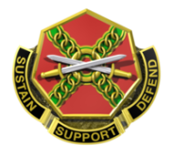
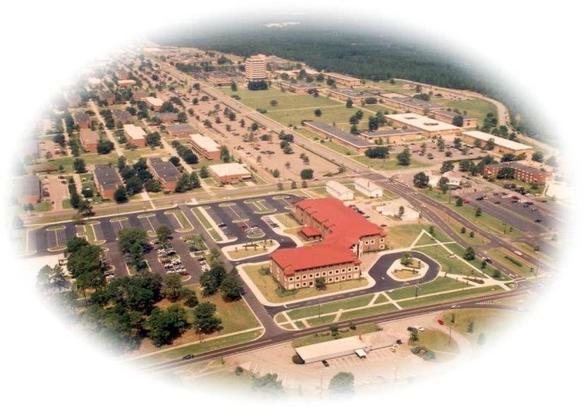
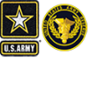
Major Commands on Fort Gordon
IMCOM / MEDCOM (21%) US Army Garrison provides and integrates base operations support;
DDEAMC provides world-class medical support to Fort Gordon and the southeast region.
Training & Doctrine (30%) Cyber CoE is the Army’s force modernization proponent for cyberspace, signal, and EW operations; trains the Cyber and Signal Soldiers through the Cyber School, Signal School, and NCO Academy
ARCYBER (11%) ARCYBER HQ maintains the Army Network, conducts Cyberspace Operations and synchronizes Information Operations across the entire Army; JFHQ-Cyber synchronizes operational cyber missions with the Joint Force. NETCOM operates and manages the Army network for ARCYBER. 7th SIG CMD (T) conducts DODIN operations within the Western Hemisphere, 7th CPB and 782nd MI BN provide global Army-wide Cyber support.
FORSCOM /INSCOM (11%) 35th Theater Tactical Signal Brigade provides expeditionary tactical signal support to COCOMs. PED Battalion provides processing, exploitation, and dissemination of intel.
116th MI BDE provides Army-wide
Aerial ISR support; 513th MI BDE provides tailored intelligence support to US Army Central (ARCENT).
Power Projection Platform for the 21st Century
NSA (22%)
NSA-G conducts missions in support of the NSA and provides support to ARCYBER operations. 706th MI BDE provides command and control to NSA-Georgia including 480th ISR (USAF), NAVIOCOM (USN), and a Marine detachment, supporting NSA-G missions.
Sister Services Navy Info Operations Command
Navy Center for Information Dominance
480th Intelligence, Surveillance and Reconnaissance Group
Company D, Marine Cryptologic Support BN
U.S. Marine Corps Detachment
USAR/ARNG (5%) US Army Reserve and US Army National Guard units conduct weekend training on Fort Gordon in support of their War time missions.
Notes:
Personal readiness involves ensuring that you and your Family are prepared for deployments. There are several key points to preparing but primarily we focus on Planning, Organization, Communication and Execution.
Don’t wait to start planning -It is better to a have a plan in place – for any part of your military life – that you may never have to use – than to not have a plan and try to build it in a critical and short amount of time – or to quote a phrase “trying to build the plane while it’s in flight.”
Organization is essential– identifying and putting your important documents together in a central location where they can be quickly and easily accessed by your or your Family member when needed. What you decide to have in a file, binder or book will depend upon your personal status and choice. We’ll address that shortly
Sharing this information – communicating what documents and information you have gathered is equally important. Whether you are in an enduring relationship or a single Soldier, someone you trust should be aware of what documents are in your plan and where they are located.

Slide 3
Army Community Service
Army Emergency Relief – Financial Readiness – Exceptional Family Member Program – Volunteer Opportunities
Family Advocacy Program – New Parent Support Program – Victim Advocacy
Relocation Readiness – Information & Referral – Employment Workshops – Survivor Outreach Services
Army Community Service
Bldg. 35200, Heritage Park Lane, 706-791-3579
Relocation Readiness Bldg. 33720, Room 172, Darling Hall, 706-791-1922
Monday-Friday, 0730-1600 (Closed Federal Holidays)
Notes:
Personal readiness involves ensuring that you and your Family are prepared for deployments. There are several key points to preparing but primarily we focus on Planning, Organization, Communication and Execution.
Don’t wait to start planning -It is better to a have a plan in place – for any part of your military life – that you may never have to use – than to not have a plan and try to build it in a critical and short amount of time – or to quote a phrase “trying to build the plane while it’s in flight.”
Organization is essential– identifying and putting your important documents together in a central location where they can be quickly and easily accessed by your or your Family member when needed. What you decide to have in a file, binder or book will depend upon your personal status and choice. We’ll address that shortly
Sharing this information – communicating what documents and information you have gathered is equally important. Whether you are in an enduring relationship or a single Soldier, someone you trust should be aware of what documents are in your plan and where they are located.

Slide 4
ACS Financial Readiness Program
E-1 – E-4
Mandatory First Termer Budget Training if Fort Gordon is your first duty station
Complete Individual budget at: https://gordon.armymwr.com/financial-readiness/first-term-training (scroll down the page and click “ACS Budget Calculator PDF”) Please follow these instructions: Email a copy of your completed budget and EOM LES to usarmy.gordon.imcom-fmwrc.mbx.acs-financial-readiness@mail.mil. Once completed, contact ACS/FRP at 706-791-3579/0795 for appointment. Appointments are scheduled on Wednesdays, from 0800-1100.
Notes:
Personal readiness involves ensuring that you and your Family are prepared for deployments. There are several key points to preparing but primarily we focus on Planning, Organization, Communication and Execution.
Don’t wait to start planning -It is better to a have a plan in place – for any part of your military life – that you may never have to use – than to not have a plan and try to build it in a critical and short amount of time – or to quote a phrase “trying to build the plane while it’s in flight.”
Organization is essential– identifying and putting your important documents together in a central location where they can be quickly and easily accessed by your or your Family member when needed. What you decide to have in a file, binder or book will depend upon your personal status and choice. We’ll address that shortly
Sharing this information – communicating what documents and information you have gathered is equally important. Whether you are in an enduring relationship or a single Soldier, someone you trust should be aware of what documents are in your plan and where they are located.

Slide 5
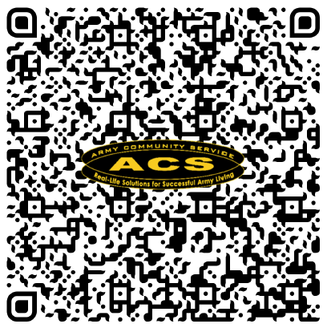
In-processing Budget Class – 1st Termer
ACS has developed a QR code for PCSing 1st Term Service Members to complete the budget requirement. This code will allow Service Members to send an email for the documents needed to complete this process.
For additional information, please contact ACS at (706) 791-3579/0795.

Slide 6
Family and Morale, Welfare and Recreation
Notes:
Personal readiness involves ensuring that you and your Family are prepared for deployments. There are several key points to preparing but primarily we focus on Planning, Organization, Communication and Execution.
Don’t wait to start planning -It is better to a have a plan in place – for any part of your military life – that you may never have to use – than to not have a plan and try to build it in a critical and short amount of time – or to quote a phrase “trying to build the plane while it’s in flight.”
Organization is essential– identifying and putting your important documents together in a central location where they can be quickly and easily accessed by your or your Family member when needed. What you decide to have in a file, binder or book will depend upon your personal status and choice. We’ll address that shortly
Sharing this information – communicating what documents and information you have gathered is equally important. Whether you are in an enduring relationship or a single Soldier, someone you trust should be aware of what documents are in your plan and where they are located.

Slide 7
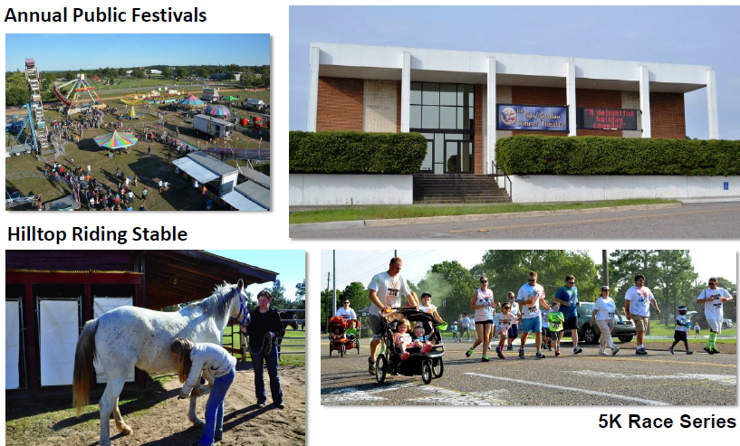
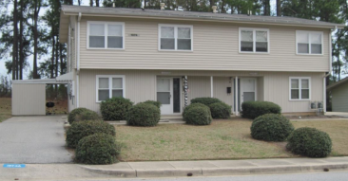
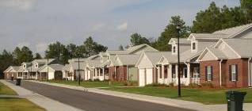
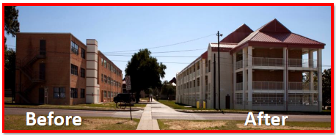
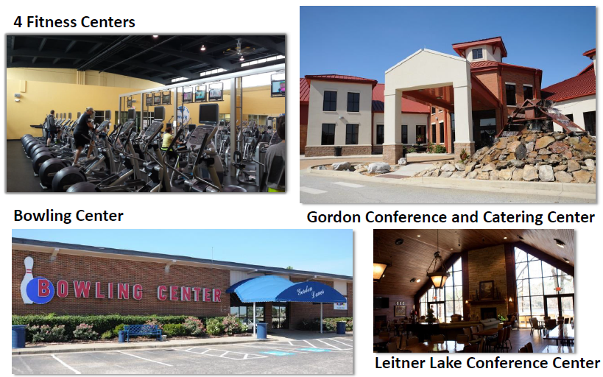
Quality of Life
Privatized Housing
Dinner Theater
6 Child Care Facilities: $23M in Reno & New Construction ‘11-’14
TRADOC Barracks Upgrade Program (TBUP) 16/19 Complete
Notes:
Personal readiness involves ensuring that you and your Family are prepared for deployments. There are several key points to preparing but primarily we focus on Planning, Organization, Communication and Execution.
Don’t wait to start planning -It is better to a have a plan in place – for any part of your military life – that you may never have to use – than to not have a plan and try to build it in a critical and short amount of time – or to quote a phrase “trying to build the plane while it’s in flight.”
Organization is essential– identifying and putting your important documents together in a central location where they can be quickly and easily accessed by your or your Family member when needed. What you decide to have in a file, binder or book will depend upon your personal status and choice. We’ll address that shortly
Sharing this information – communicating what documents and information you have gathered is equally important. Whether you are in an enduring relationship or a single Soldier, someone you trust should be aware of what documents are in your plan and where they are located.

Slide 8
Family and Morale, Welfare and Recreation
Child & Youth Services
SKIES
Robotics, Art, & more!
Instructors wanted
Youth Sports & Fitness
Middle School & Teen Center
Leisure & Recreation
Life Skills & Leadership Opportunities
Before & After Hour School Care
Transportation to/from most off-post schools
Mentoring, Clubs, etc.
School Liaison: (706) 791-7270
Parent & Outreach: (706) 791-4455
Notes:
Personal readiness involves ensuring that you and your Family are prepared for deployments. There are several key points to preparing but primarily we focus on Planning, Organization, Communication and Execution.
Don’t wait to start planning -It is better to a have a plan in place – for any part of your military life – that you may never have to use – than to not have a plan and try to build it in a critical and short amount of time – or to quote a phrase “trying to build the plane while it’s in flight.”
Organization is essential– identifying and putting your important documents together in a central location where they can be quickly and easily accessed by your or your Family member when needed. What you decide to have in a file, binder or book will depend upon your personal status and choice. We’ll address that shortly
Sharing this information – communicating what documents and information you have gathered is equally important. Whether you are in an enduring relationship or a single Soldier, someone you trust should be aware of what documents are in your plan and where they are located.

Slide 9
Family and Morale, Welfare and Recreation
Outdoor Recreation
Pointes West Army Resort
Beach, Cabin Rentals, Trails
Tactical Advantage Sportsman’s Complex (TASC)
Hunting, Fishing, Archery
Recreational Ranges
Equipment Rental
Hilltop Riding Stables
Trail Rides, Birthday Parties
Summer Camps
Community Garden
Notes:
Personal readiness involves ensuring that you and your Family are prepared for deployments. There are several key points to preparing but primarily we focus on Planning, Organization, Communication and Execution.
Don’t wait to start planning -It is better to a have a plan in place – for any part of your military life – that you may never have to use – than to not have a plan and try to build it in a critical and short amount of time – or to quote a phrase “trying to build the plane while it’s in flight.”
Organization is essential– identifying and putting your important documents together in a central location where they can be quickly and easily accessed by your or your Family member when needed. What you decide to have in a file, binder or book will depend upon your personal status and choice. We’ll address that shortly
Sharing this information – communicating what documents and information you have gathered is equally important. Whether you are in an enduring relationship or a single Soldier, someone you trust should be aware of what documents are in your plan and where they are located.

Slide 10
Family and Morale, Welfare and Recreation
Sports & Fitness
Sports Equipment Rental
Sports Balls - Jerseys
Tug-o-War Ropes
And more…
Gyms
Strength Board, Circuit Training, etc.
Run Series
Superheroes, Dr. Seuss, Glow, etc.
Intramural Sports
Kickball – Softball – Football - Basketball
Warrior Adventure Quest
Aquatics
Indoor Pool (lap pool)
Outdoor Pool & Spray Park
Gordon Lanes Bowling Center
Pro Shop
Birthday Parties, Summer Specials
Disc Golf Course
Army/Air Force Course
Marines/Navy Course
Gordon Lakes Golf Course
PGA Instructors - Pro Shop
Tournament Pavilion
Notes:
Personal readiness involves ensuring that you and your Family are prepared for deployments. There are several key points to preparing but primarily we focus on Planning, Organization, Communication and Execution.
Don’t wait to start planning -It is better to a have a plan in place – for any part of your military life – that you may never have to use – than to not have a plan and try to build it in a critical and short amount of time – or to quote a phrase “trying to build the plane while it’s in flight.”
Organization is essential– identifying and putting your important documents together in a central location where they can be quickly and easily accessed by your or your Family member when needed. What you decide to have in a file, binder or book will depend upon your personal status and choice. We’ll address that shortly
Sharing this information – communicating what documents and information you have gathered is equally important. Whether you are in an enduring relationship or a single Soldier, someone you trust should be aware of what documents are in your plan and where they are located.

Slide 11
Legal Assistance Division
Contact Information
Legal Assistance Division
267 Heritage Park Lane
Building 35202
(706) 791-7812/7813
and
Darling Hall, Room 191
Notes:
Personal readiness involves ensuring that you and your Family are prepared for deployments. There are several key points to preparing but primarily we focus on Planning, Organization, Communication and Execution.
Don’t wait to start planning -It is better to a have a plan in place – for any part of your military life – that you may never have to use – than to not have a plan and try to build it in a critical and short amount of time – or to quote a phrase “trying to build the plane while it’s in flight.”
Organization is essential– identifying and putting your important documents together in a central location where they can be quickly and easily accessed by your or your Family member when needed. What you decide to have in a file, binder or book will depend upon your personal status and choice. We’ll address that shortly
Sharing this information – communicating what documents and information you have gathered is equally important. Whether you are in an enduring relationship or a single Soldier, someone you trust should be aware of what documents are in your plan and where they are located.

Slide 12
SHARP
Notes:
Personal readiness involves ensuring that you and your Family are prepared for deployments. There are several key points to preparing but primarily we focus on Planning, Organization, Communication and Execution.
Don’t wait to start planning -It is better to a have a plan in place – for any part of your military life – that you may never have to use – than to not have a plan and try to build it in a critical and short amount of time – or to quote a phrase “trying to build the plane while it’s in flight.”
Organization is essential– identifying and putting your important documents together in a central location where they can be quickly and easily accessed by your or your Family member when needed. What you decide to have in a file, binder or book will depend upon your personal status and choice. We’ll address that shortly
Sharing this information – communicating what documents and information you have gathered is equally important. Whether you are in an enduring relationship or a single Soldier, someone you trust should be aware of what documents are in your plan and where they are located.

Slide 13
Army Substance Abuse Program
Contact Information
Army Substance Abuse Program
202 7th Avenue
Building 38702 (706) 791-5797/3985
Notes:
Personal readiness involves ensuring that you and your Family are prepared for deployments. There are several key points to preparing but primarily we focus on Planning, Organization, Communication and Execution.
Don’t wait to start planning -It is better to a have a plan in place – for any part of your military life – that you may never have to use – than to not have a plan and try to build it in a critical and short amount of time – or to quote a phrase “trying to build the plane while it’s in flight.”
Organization is essential– identifying and putting your important documents together in a central location where they can be quickly and easily accessed by your or your Family member when needed. What you decide to have in a file, binder or book will depend upon your personal status and choice. We’ll address that shortly
Sharing this information – communicating what documents and information you have gathered is equally important. Whether you are in an enduring relationship or a single Soldier, someone you trust should be aware of what documents are in your plan and where they are located.

Slide 14
Installation Chaplain’s Office
Contact Information
Center Chaplain’s Office
Building 29601, Barnes Avenue
(706) 791-5653
Notes:
Personal readiness involves ensuring that you and your Family are prepared for deployments. There are several key points to preparing but primarily we focus on Planning, Organization, Communication and Execution.
Don’t wait to start planning -It is better to a have a plan in place – for any part of your military life – that you may never have to use – than to not have a plan and try to build it in a critical and short amount of time – or to quote a phrase “trying to build the plane while it’s in flight.”
Organization is essential– identifying and putting your important documents together in a central location where they can be quickly and easily accessed by your or your Family member when needed. What you decide to have in a file, binder or book will depend upon your personal status and choice. We’ll address that shortly
Sharing this information – communicating what documents and information you have gathered is equally important. Whether you are in an enduring relationship or a single Soldier, someone you trust should be aware of what documents are in your plan and where they are located.

Slide 15
Garrison Housing Services Office
Contact Information
Garrison Housing Services Office
Darling Hall, Room 129
(706) 791-5116
Notes:
Personal readiness involves ensuring that you and your Family are prepared for deployments. There are several key points to preparing but primarily we focus on Planning, Organization, Communication and Execution.
Don’t wait to start planning -It is better to a have a plan in place – for any part of your military life – that you may never have to use – than to not have a plan and try to build it in a critical and short amount of time – or to quote a phrase “trying to build the plane while it’s in flight.”
Organization is essential– identifying and putting your important documents together in a central location where they can be quickly and easily accessed by your or your Family member when needed. What you decide to have in a file, binder or book will depend upon your personal status and choice. We’ll address that shortly
Sharing this information – communicating what documents and information you have gathered is equally important. Whether you are in an enduring relationship or a single Soldier, someone you trust should be aware of what documents are in your plan and where they are located.

Slide 16
Managed Care
Contact Information
DDEAMC, 2nd Floor
(706) 787-5811/5022
Humana Military
TRICARE East Region
(800) 444-5445
Notes:
Personal readiness involves ensuring that you and your Family are prepared for deployments. There are several key points to preparing but primarily we focus on Planning, Organization, Communication and Execution.
Don’t wait to start planning -It is better to a have a plan in place – for any part of your military life – that you may never have to use – than to not have a plan and try to build it in a critical and short amount of time – or to quote a phrase “trying to build the plane while it’s in flight.”
Organization is essential– identifying and putting your important documents together in a central location where they can be quickly and easily accessed by your or your Family member when needed. What you decide to have in a file, binder or book will depend upon your personal status and choice. We’ll address that shortly
Sharing this information – communicating what documents and information you have gathered is equally important. Whether you are in an enduring relationship or a single Soldier, someone you trust should be aware of what documents are in your plan and where they are located.

Slide 17
MFLC
Military Family Life Counselor
Non-medical short-term, situational problem-solving counseling to Service Members and their families
Life Skills such as anger management, relationship issues, decision-making skills and communication
Military Lifestyle services include deployment stress, coping skills, relocation adjustment, homesickness and separation
Services are confidential and private, except for duty to warn situations
Command Support Center
Army Community Service Suite
271 Heritage Park Ln
Building 35200
(706) 877-0979
35th Signal BDE (706) 691-7338
480th ISR (706) 755-4143
Notes:
Personal readiness involves ensuring that you and your Family are prepared for deployments. There are several key points to preparing but primarily we focus on Planning, Organization, Communication and Execution.
Don’t wait to start planning -It is better to a have a plan in place – for any part of your military life – that you may never have to use – than to not have a plan and try to build it in a critical and short amount of time – or to quote a phrase “trying to build the plane while it’s in flight.”
Organization is essential– identifying and putting your important documents together in a central location where they can be quickly and easily accessed by your or your Family member when needed. What you decide to have in a file, binder or book will depend upon your personal status and choice. We’ll address that shortly
Sharing this information – communicating what documents and information you have gathered is equally important. Whether you are in an enduring relationship or a single Soldier, someone you trust should be aware of what documents are in your plan and where they are located.

Slide 18
Pets
Microchips Mandatory
Update your contact information!
Fort Gordon Veterinary Clinic (706) 787-7375
Inoculations
Well pet care
Sick pet care
No emergency services
Augusta Animal Emergency
ONLY after-hours emergency care clinic
Notes:
Personal readiness involves ensuring that you and your Family are prepared for deployments. There are several key points to preparing but primarily we focus on Planning, Organization, Communication and Execution.
Don’t wait to start planning -It is better to a have a plan in place – for any part of your military life – that you may never have to use – than to not have a plan and try to build it in a critical and short amount of time – or to quote a phrase “trying to build the plane while it’s in flight.”
Organization is essential– identifying and putting your important documents together in a central location where they can be quickly and easily accessed by your or your Family member when needed. What you decide to have in a file, binder or book will depend upon your personal status and choice. We’ll address that shortly
Sharing this information – communicating what documents and information you have gathered is equally important. Whether you are in an enduring relationship or a single Soldier, someone you trust should be aware of what documents are in your plan and where they are located.

Slide 19
Navigating Fort Gordon
Gate Access
Gate 1 (McKenna Gate): 24/7
Visitor Control Center (VCC): 0600 – 2000 Daily
Anyone without DoD ID or AIE Card MUST stop at VCC
Gate 2: Robinson Ave @ Gordon Hwy (Grovetown)
0400-2000 Monday-Friday
Gate 5: Tobacco Road (Hephzibah)
0430-0100 Daily
100% ID Card Check for all occupants aged 18 or older
Notes:
Personal readiness involves ensuring that you and your Family are prepared for deployments. There are several key points to preparing but primarily we focus on Planning, Organization, Communication and Execution.
Don’t wait to start planning -It is better to a have a plan in place – for any part of your military life – that you may never have to use – than to not have a plan and try to build it in a critical and short amount of time – or to quote a phrase “trying to build the plane while it’s in flight.”
Organization is essential– identifying and putting your important documents together in a central location where they can be quickly and easily accessed by your or your Family member when needed. What you decide to have in a file, binder or book will depend upon your personal status and choice. We’ll address that shortly
Sharing this information – communicating what documents and information you have gathered is equally important. Whether you are in an enduring relationship or a single Soldier, someone you trust should be aware of what documents are in your plan and where they are located.

Slide 20
Navigating Fort Gordon
Download the “Digital Garrison” App

Slide 21
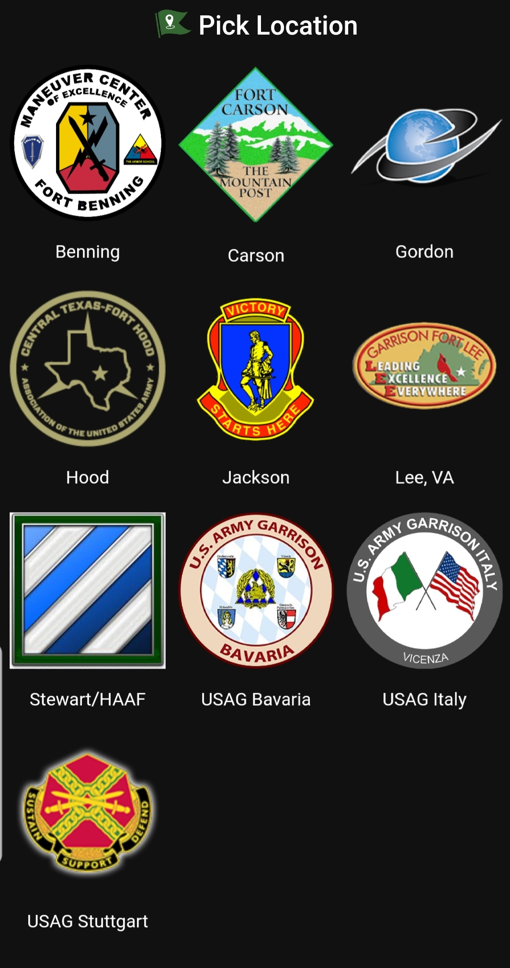
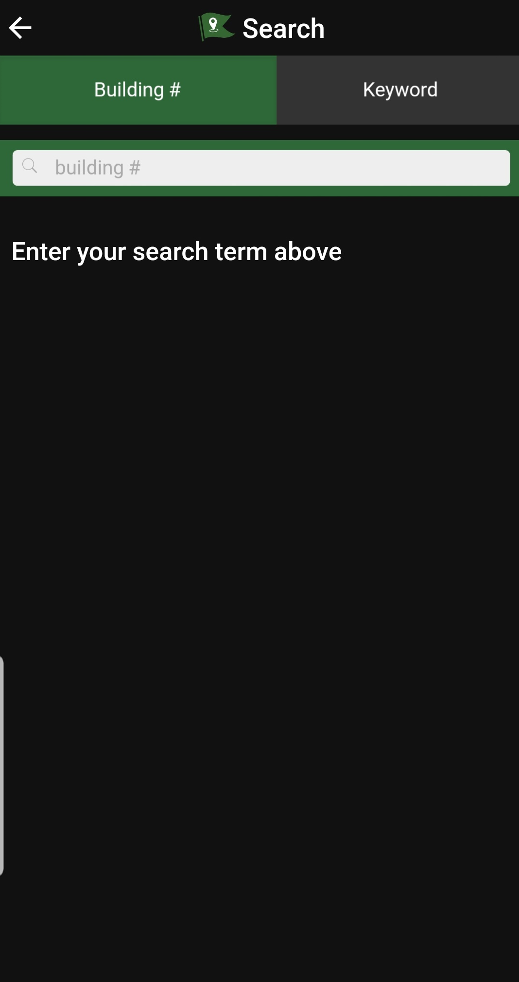
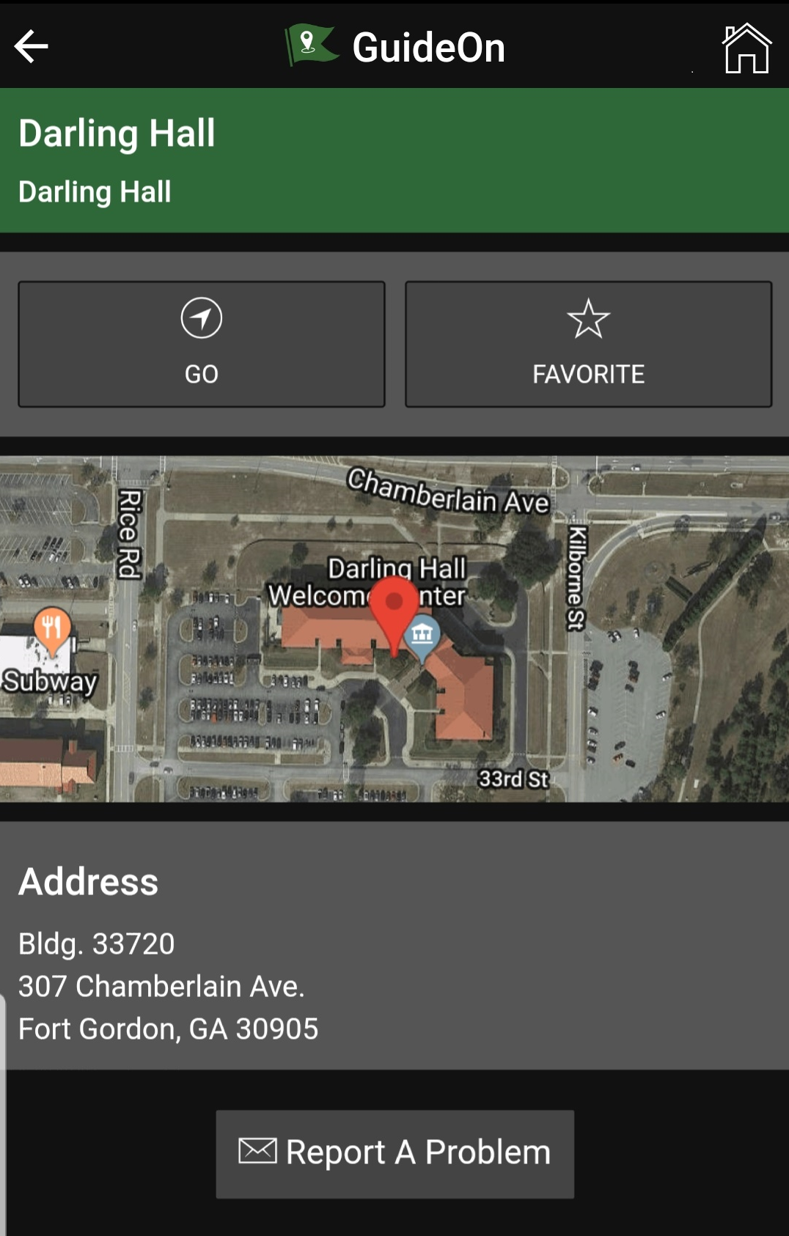
Navigating Fort Gordon
Download the “Guide On” App
Notes:
Personal readiness involves ensuring that you and your Family are prepared for deployments. There are several key points to preparing but primarily we focus on Planning, Organization, Communication and Execution.
Don’t wait to start planning -It is better to a have a plan in place – for any part of your military life – that you may never have to use – than to not have a plan and try to build it in a critical and short amount of time – or to quote a phrase “trying to build the plane while it’s in flight.”
Organization is essential– identifying and putting your important documents together in a central location where they can be quickly and easily accessed by your or your Family member when needed. What you decide to have in a file, binder or book will depend upon your personal status and choice. We’ll address that shortly
Sharing this information – communicating what documents and information you have gathered is equally important. Whether you are in an enduring relationship or a single Soldier, someone you trust should be aware of what documents are in your plan and where they are located.

Slide 22
Local Information
What is there to do?
Annual Events
Local Attractions
The Masters Golf Tournament
April (ticket lottery in March – MWR)
Papa Joe’s Banjo-B-Que
Thunder Over Augusta/Evans
TechNet Augusta
Arts in the Heart of Augusta
Augusta Canal Festival
Christmas in Hopelands
Lights of the South
Concert / Event Venues
James Brown Arena, Bell Auditorium
Imperial Theater, Miller Theater
SRP Park
Downtown Area
Local shops, eateries, farmers market
Museums, historical sites
Artists Row
Outdoor
Augusta Canal & Riverwalk
Phinizy Swamp
Notes:
Personal readiness involves ensuring that you and your Family are prepared for deployments. There are several key points to preparing but primarily we focus on Planning, Organization, Communication and Execution.
Don’t wait to start planning -It is better to a have a plan in place – for any part of your military life – that you may never have to use – than to not have a plan and try to build it in a critical and short amount of time – or to quote a phrase “trying to build the plane while it’s in flight.”
Organization is essential– identifying and putting your important documents together in a central location where they can be quickly and easily accessed by your or your Family member when needed. What you decide to have in a file, binder or book will depend upon your personal status and choice. We’ll address that shortly
Sharing this information – communicating what documents and information you have gathered is equally important. Whether you are in an enduring relationship or a single Soldier, someone you trust should be aware of what documents are in your plan and where they are located.

Slide 23
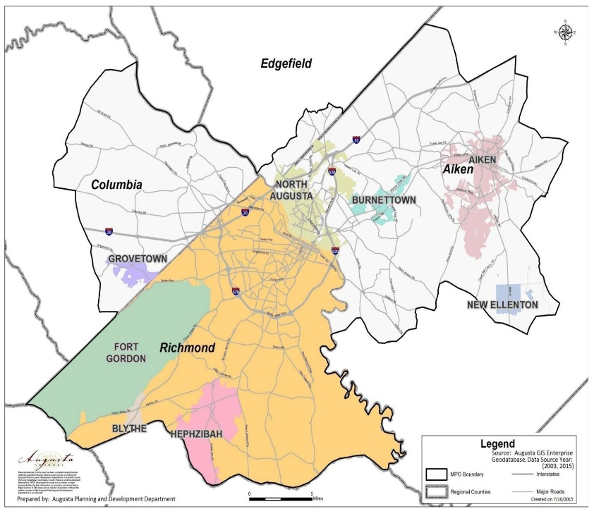
Local Information
Major Counties
Richmond County
Augusta
Fort Gordon
Hephzibah
Columbia County
Evans
Martinez
Grovetown
Where you live and where you work may be separate counties with separate services.
Notes:
Personal readiness involves ensuring that you and your Family are prepared for deployments. There are several key points to preparing but primarily we focus on Planning, Organization, Communication and Execution.
Don’t wait to start planning -It is better to a have a plan in place – for any part of your military life – that you may never have to use – than to not have a plan and try to build it in a critical and short amount of time – or to quote a phrase “trying to build the plane while it’s in flight.”
Organization is essential– identifying and putting your important documents together in a central location where they can be quickly and easily accessed by your or your Family member when needed. What you decide to have in a file, binder or book will depend upon your personal status and choice. We’ll address that shortly
Sharing this information – communicating what documents and information you have gathered is equally important. Whether you are in an enduring relationship or a single Soldier, someone you trust should be aware of what documents are in your plan and where they are located.

Slide 24
Please contact the Relocation Office if you have any questions at 706-791-1922, Monday-Friday 0730-1600.
Notes:
Personal readiness involves ensuring that you and your Family are prepared for deployments. There are several key points to preparing but primarily we focus on Planning, Organization, Communication and Execution.
Don’t wait to start planning -It is better to a have a plan in place – for any part of your military life – that you may never have to use – than to not have a plan and try to build it in a critical and short amount of time – or to quote a phrase “trying to build the plane while it’s in flight.”
Organization is essential– identifying and putting your important documents together in a central location where they can be quickly and easily accessed by your or your Family member when needed. What you decide to have in a file, binder or book will depend upon your personal status and choice. We’ll address that shortly
Sharing this information – communicating what documents and information you have gathered is equally important. Whether you are in an enduring relationship or a single Soldier, someone you trust should be aware of what documents are in your plan and where they are located.

Slide 25
Certificate of Completion
This certificate is presented to
For successfully completing Fort Gordon Newcomer’s Orientation
offered by
Army Community Service, Relocation Readiness Program
Sharell Byrd
Army Community Service Specialist, Relocation
Army Community Service
Date

